Slide 1
Labor Distribution in Mexico
Sara Carolina Gómez Delgado
Luis Eduardo Robles Jiménez

Slide 2

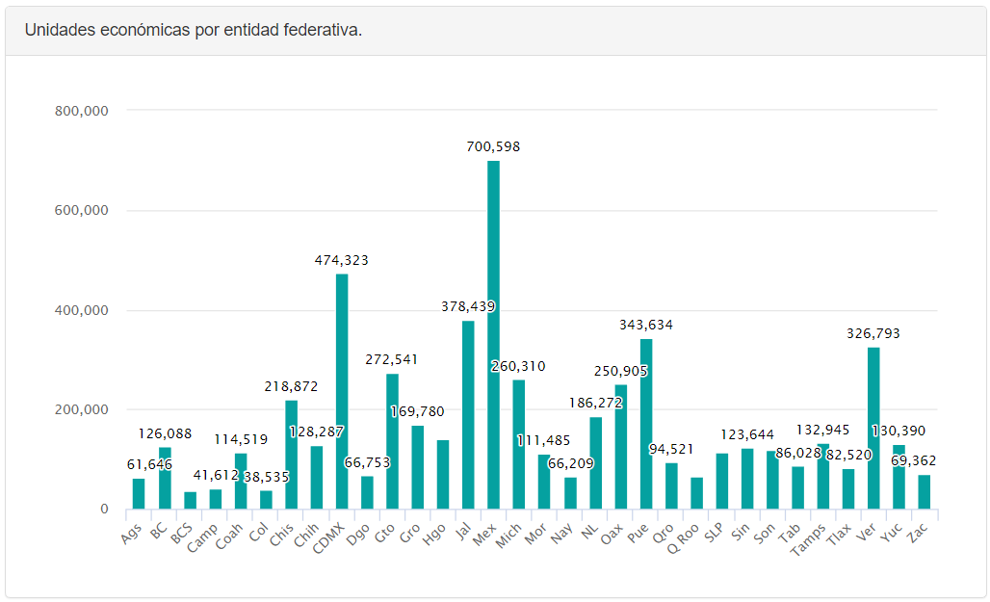
Background
Labor in Mexico is an important topic that has been the subject of many discussions. The Mexican workforce is diverse and comprises countless workers who are engaged in various sectors such as agriculture, manufacturing, services, and more.

Slide 3

Problem
Perform an exploratory analysis of the workforce in Mexico. Its social implications and consequences.
Understand and explain the behavior of society in the following topics:
Gender distribution
Working people
Jobs as people attractor
Health services behavior
Illiteracy

Slide 4
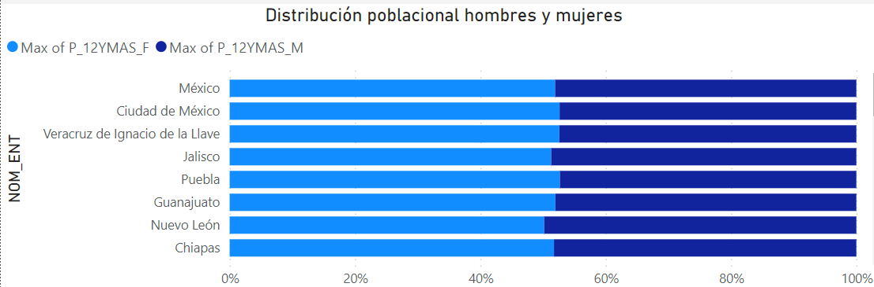
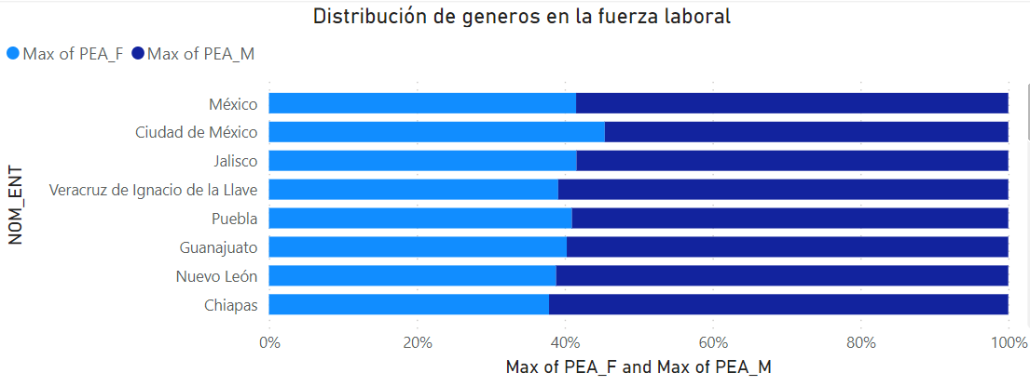
Approach
Gender distribution
Zacatecas keeps the record with the smallest proportion of women working.
Being 36% women and 64% men in its workforce.

Slide 5
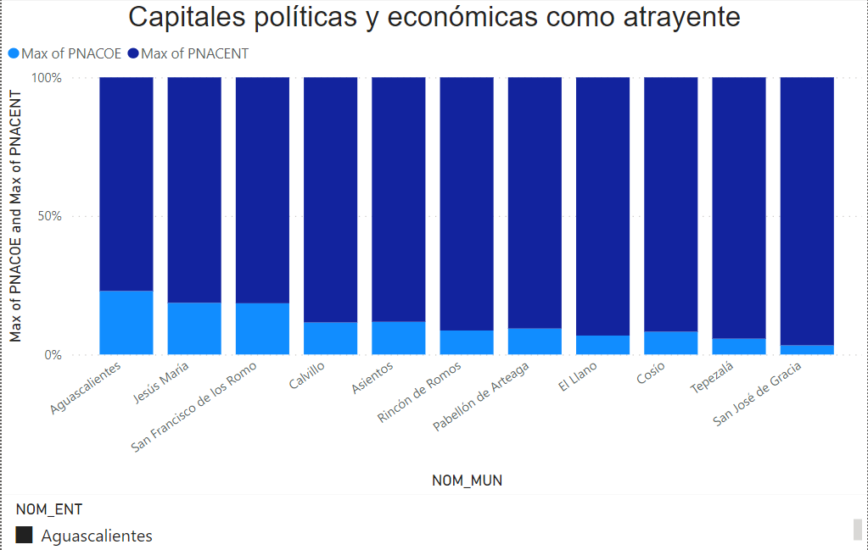
Approach
Jobs as people attractor

Slide 6
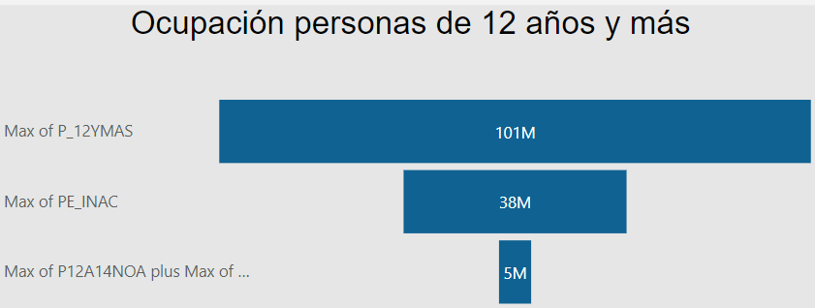
Approach
Working people

Slide 7
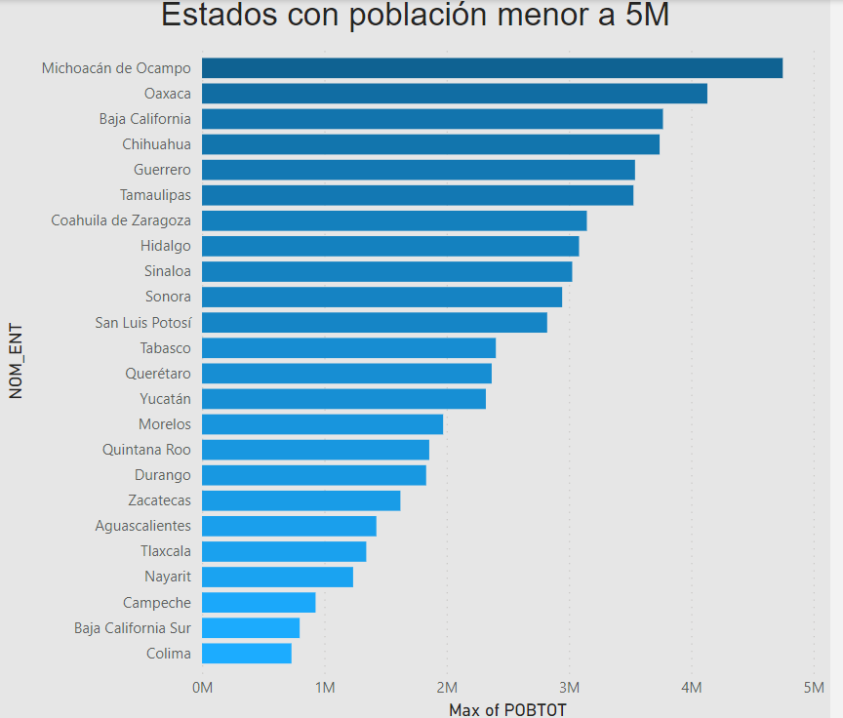
Approach
Working people

Slide 8
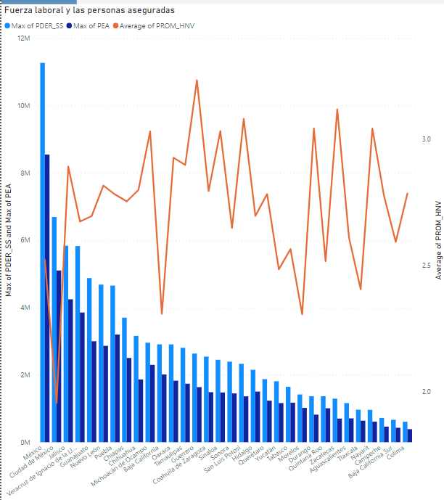
Approach
Health services behavior
Here we can see the relation between the workforce and people under any insurance services (lighter bar). The polyline represents the average number of children by family, and we can spot something interesting.
Counter-intuitive?

Slide 9
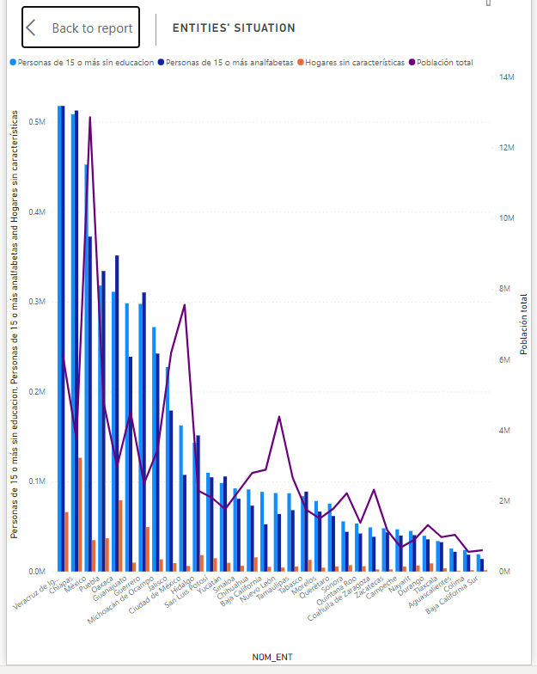
Approach
Illiteracy
What can this graph tell us about the wellbeing of an entity?
- Chiapas

Slide 10
References
This analysis was made from Inegi’s 2020 census

